Slide 1


Siggi Nagele
Certified College Advisor with Advanced Credentials
College Recruiting Process Overview

Slide 2
1.
Background and Clients
2.
Competition for College Rosters
3.
Academics & Coaches Evaluations
Agenda
4.
Scholarships and Timelines
5.
How to get recruited
6.
Camps, etc.
7.
Questions

Slide 3

“Son, we love you very much, but if you want to go to college, you will have to figure out what the best school is for you and how to pay for it!”
- Carl & Erika Adams, 1980 -

Slide 4
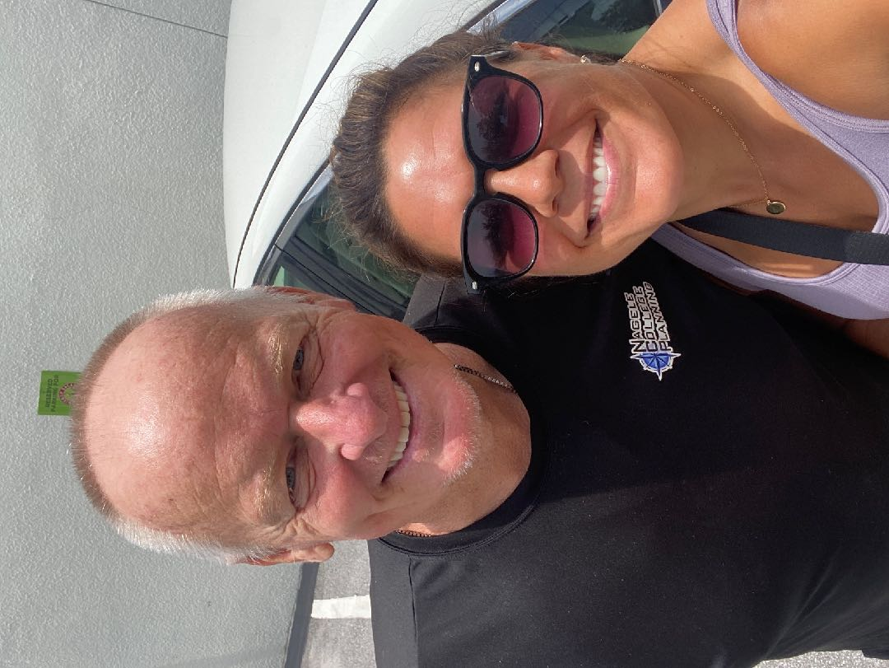

Slide 5
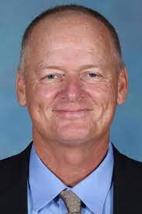

Who is Siggi Nagele?
Coaching Experience/Career:
40+ years experience at ODP, Club, HS, College Level
Women’s College Soccer
  Eckerd, Head Coach
  Florida Southern, Head Coach
  Marshall University- Asst Coach
Olympic Development Program- FYSA Region 3
English/ German Teacher- Ridgewood HS
Soccer Administration:
NCAA National Chairman- Div II Women’s Soccer Committee
NSCAA South Region Chair All American Committee
College Recruiting Company Founder and Owner
Soccer Experience:
Alderson- Broaddus College
  4-year Collegiate starter with Full Scholarship
  2-time National Championship Finalist
Education:
Master of Science, Marshall University

Slide 6


Slide 7
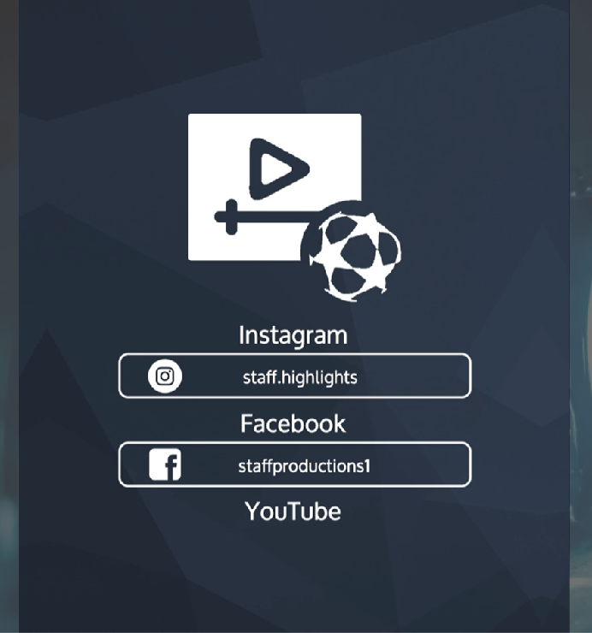


Slide 8


Slide 9

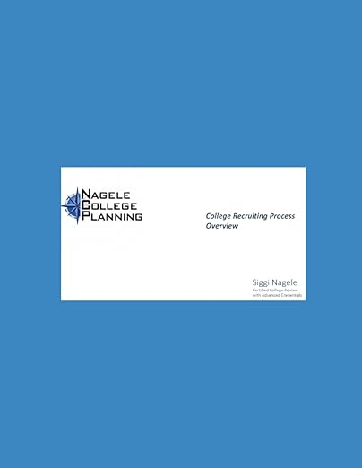

Slide 10
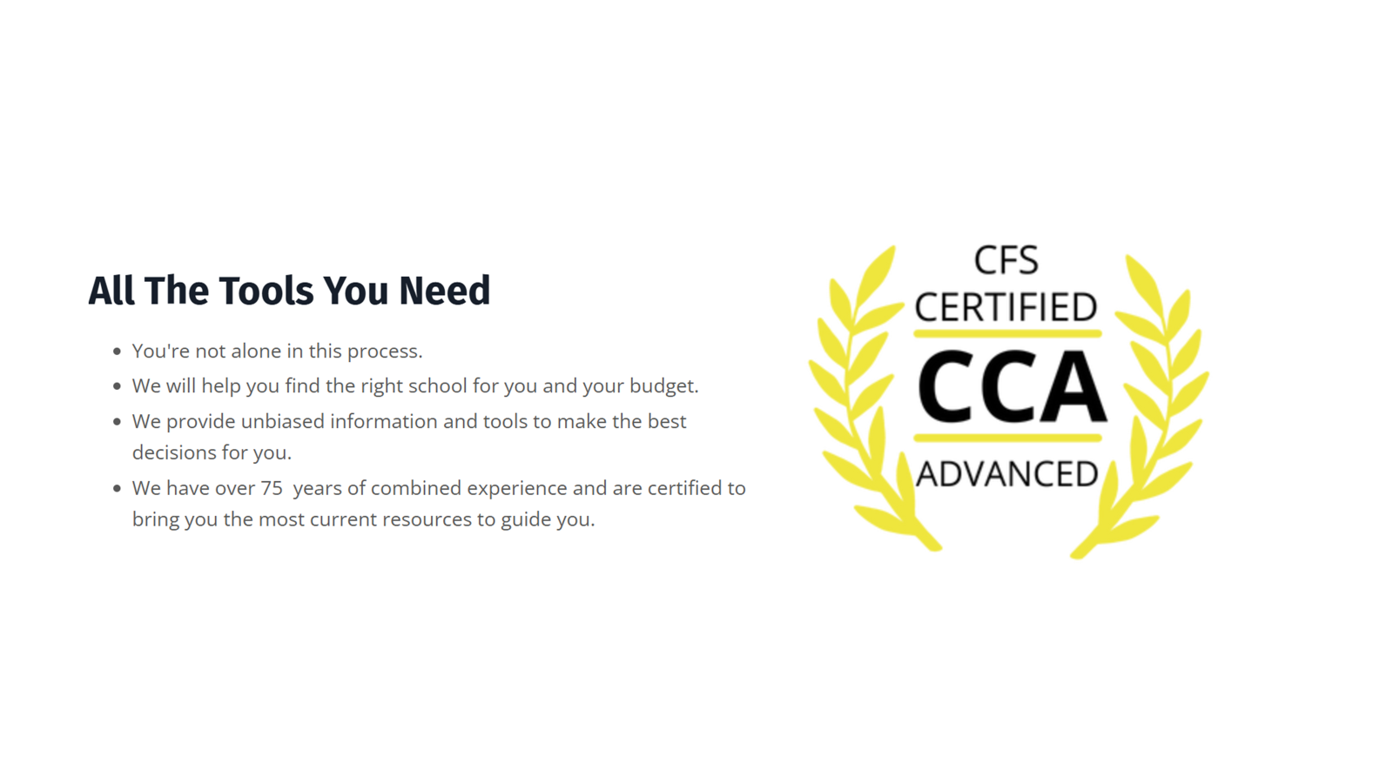

Slide 11
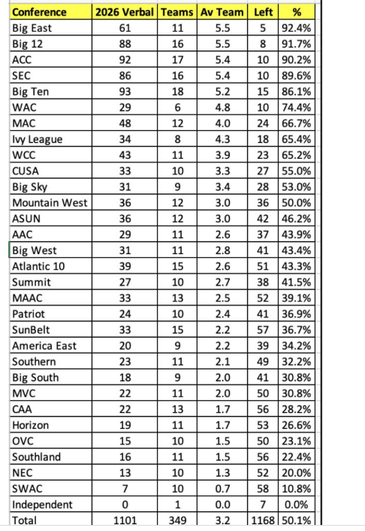

Slide 12

The 12 Keys to Success in the College Recruiting Process

Slide 13
Your True Playing Level
Your Budget
How College is being paid for
Grades and Test Scores
Location & Size of School
Potential Scholarships – Academic/Athletic
Is that College looking to recruit your Position
What is the Style, Culture, History, Track Record. Look at roster four years ago & see freshmen vs. seniors
Soccer vs. Academics Importance
Career Path Decision/ Majors offered
Is being a Starter Year 1 important
How many players at your position & when do they graduate. Also, where do they recruit from.

Slide 14

The traditional recruiting platforms put the burden on college coaches to drive the recruiting process, which takes control away from the student-athletes. College coaches are busy, and can't spend their entire working day on recruiting - let alone keep up with all the different platforms out there.
I believe that the recruiting process should be owned by the student-athlete.

Slide 15
College Coach Database
Never search for contact information online again. We update our database each month with the freshest, most accurate data.
College Recruiting CRM
Email coaches, manage tasks, log calls, track profile views, add notes, and more — all in one place.
Email Tracking
See when college coaches open your emails and click on links.
Modern Online Profiles
Customize it and share with college coaches. Download it as a resume PDF with a QR Code for camps and showcases.
Recruiting Task Management
Athletes get notified for overdue tasks so you never forget to follow up.
Create Recruiting Checklists
Partners can generate checklists for their athletes to keep them on track throughout the recruiting process and give them the support they need.
Mobile Web App
Recruiting on the go with a mobile first experience.
Humane Customer Support
We are always here to help you with your recruiting process and can help solve any issues you are having with the platform.
We’re small & scrappy
Get help directly from the founder, who is a former college soccer player.

Slide 16








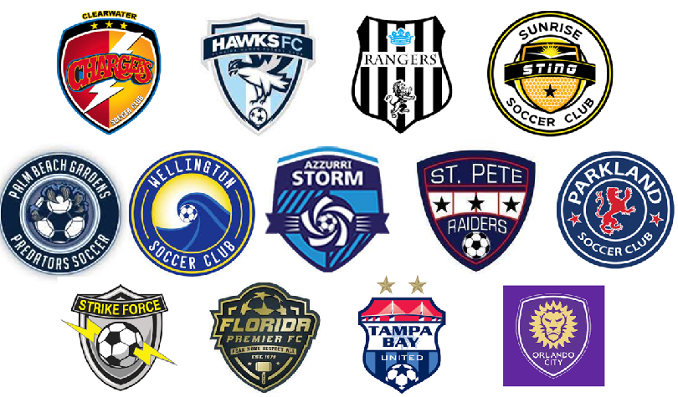



Teams and Players Represented

Slide 17
















Slide 18














Slide 19









Slide 20
Playing in College

Slide 21
Key Points
Only 7% of HS athletes play at the College Level- playing any Division is AWESOME!
The higher your GPA, the more options you give yourself
Your attitude is key, and your Club and HS coach will be consulted by colleges interested in you
Don’t let pre-conceived notions about DI guide you- your fit with the school is the most important aspect of your search

Slide 22
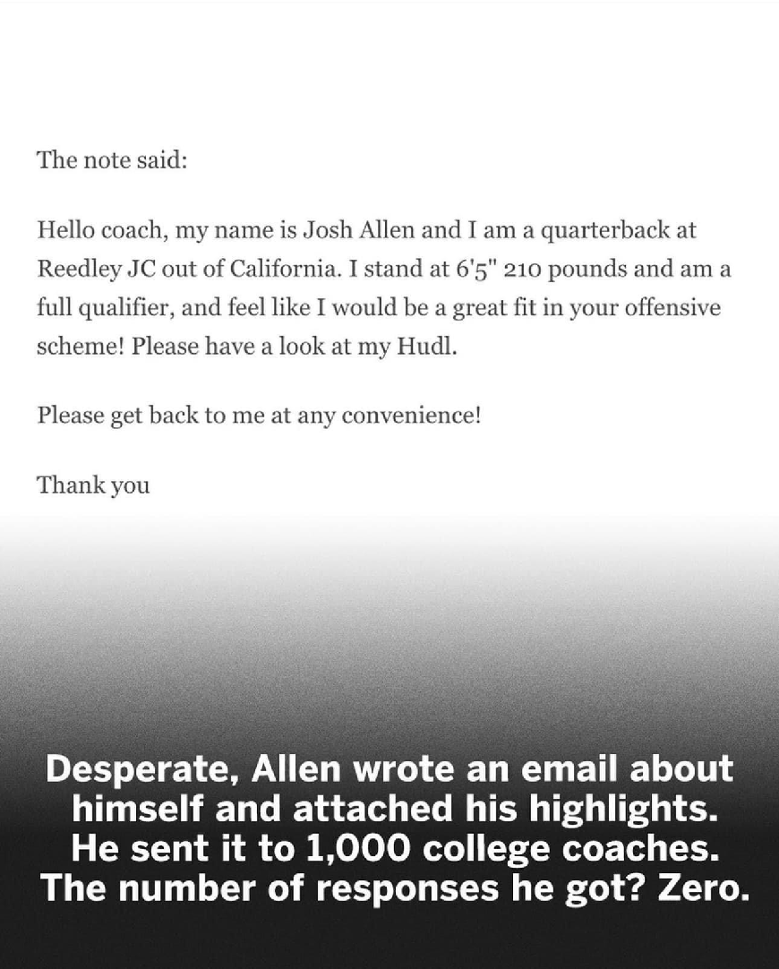

Slide 23
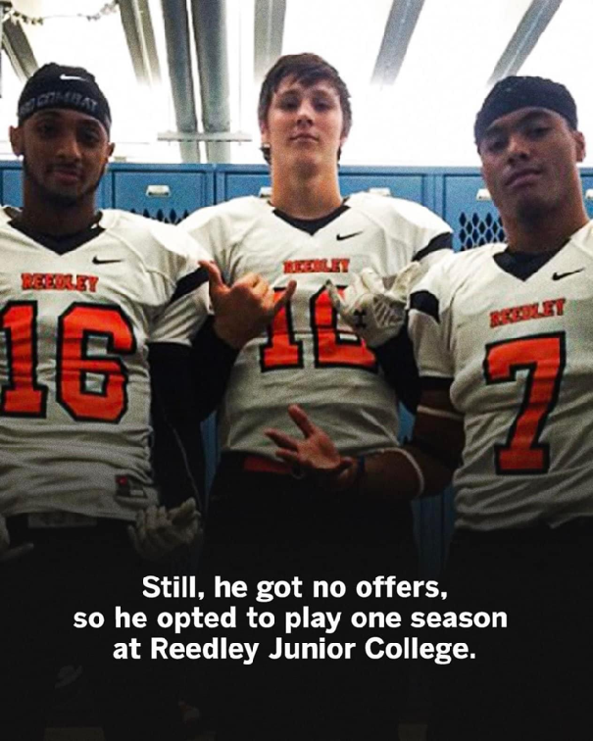
Received no scholarship offers from any NCAA Division I program

Slide 24
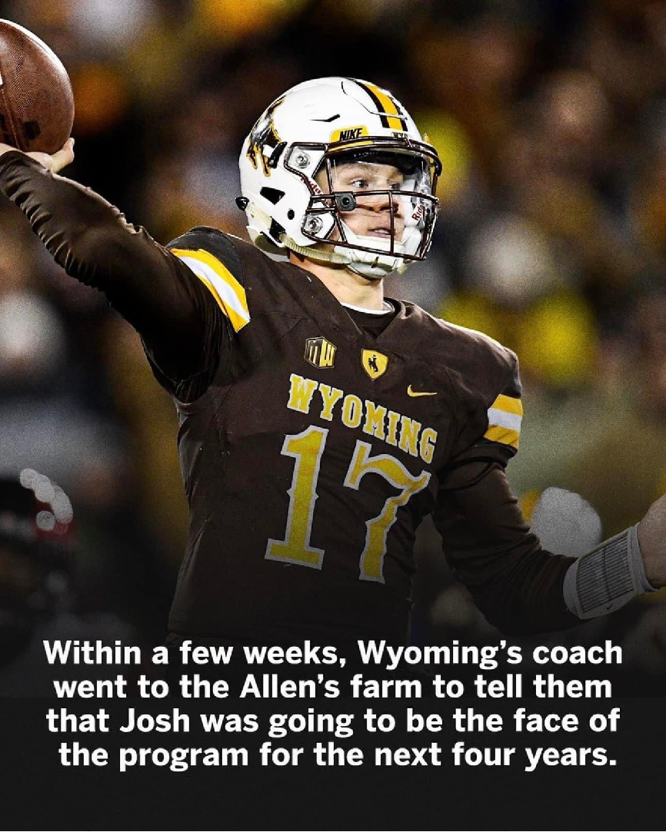

Slide 25
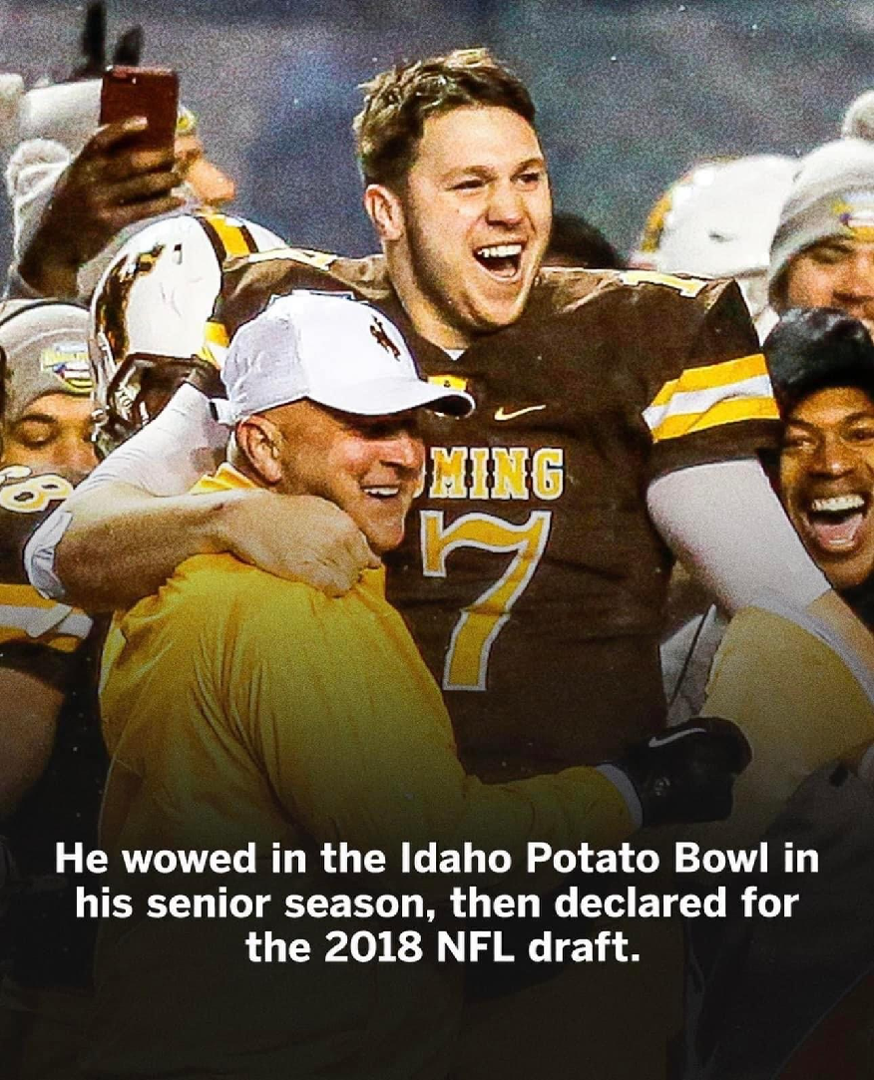

Slide 26
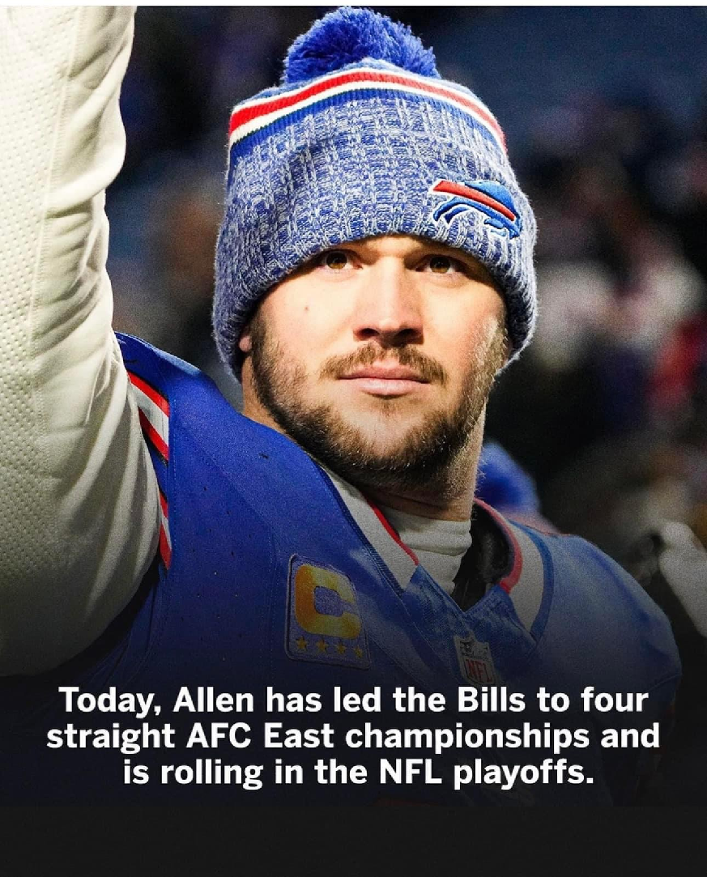

Slide 27
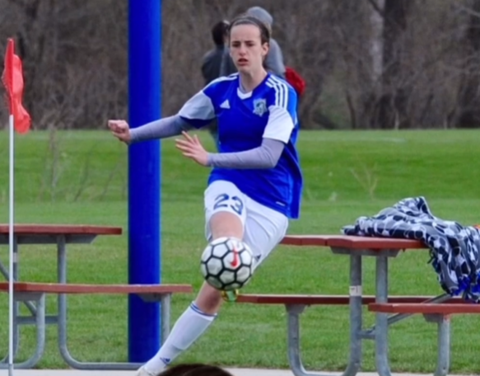
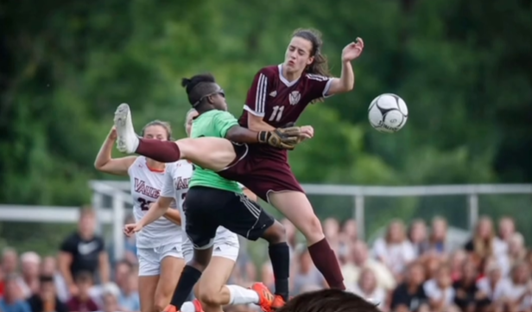

Slide 28
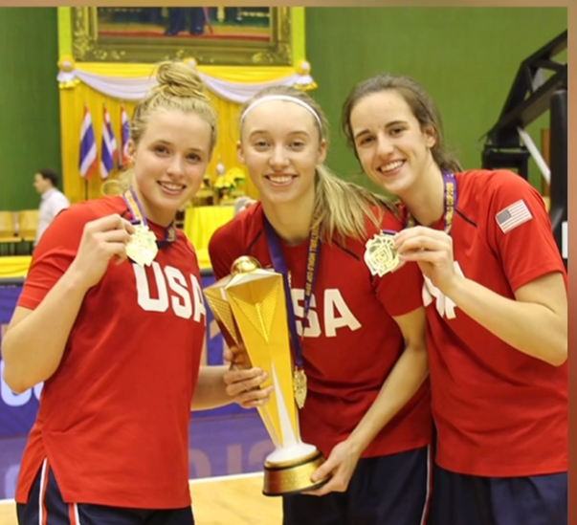

Slide 29
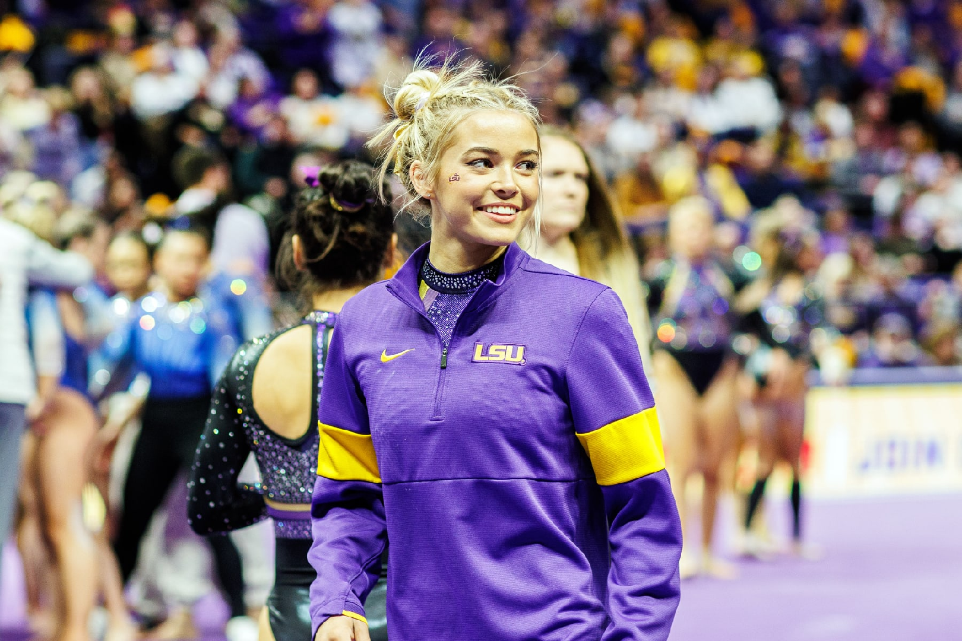

Slide 30
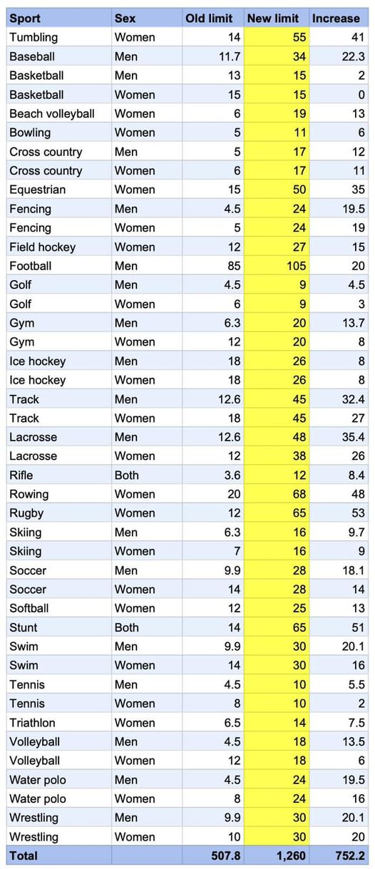

Slide 31
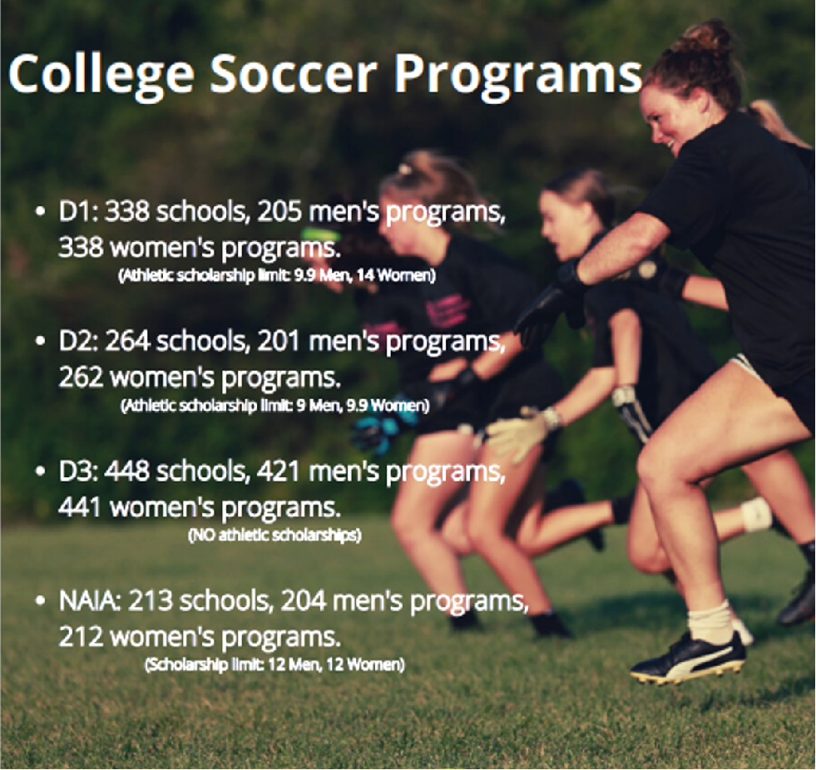
Statistics on playing in College
The odds are more challenging for Men
The odds of Women playing D1 is much higher than Men:
  Male: 119:1, .8%
  Female: 48:1, 2.1%
Odds of playing at any College Level:
  Male 14:1, 7.4%
  Female 10:1, 9.7%
There are 40% fewer Men’s D1 Programs:
  Male: 205
  Female: 338
There are 16% more male HS players than Female:
  Male: 476,203
  Female: 408,807
There is a higher % of Male international players:
  Male: 34%
  Female: 11%

Slide 32
Playing at one of Florida’s 8 DI Women’s Programs
2022-2023 Season Total of Freshmen Recruited
41
2022-2023 Season Total of Freshmen Recruited (low due to coaching changes at UF and FSU)
10
International Players
9
Out of State Players
22
Florida Players
5
Players who played >10 games
11
Players who played 1-9 games
6
Players who did not play

Slide 33
Your competition is players already playing at the Collegiate Level
NCAA Transfer Portal: # of players already playing in College, looking to move to a new college
 | May 2023 | May 2022 | YoY Growth
Men’s | 3,027 | 1,431 | +111%
Women’s | 2,256 | 989 | +128%

Slide 34
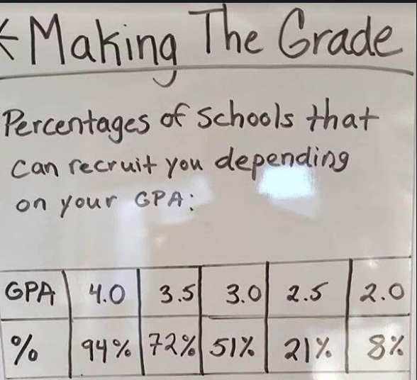
The importance of your Grades
A higher GPA= More Recruiting Possibilities
The Message:
Excelling in school opens up your possibilities of where you can play!!!

Slide 35
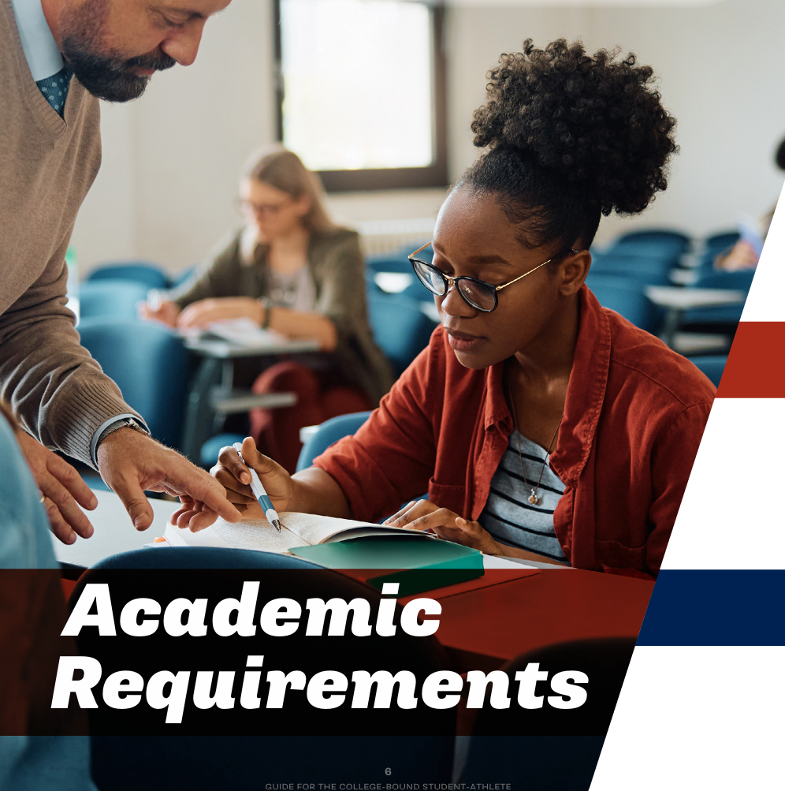
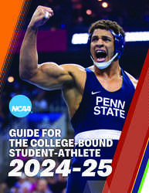

Slide 36
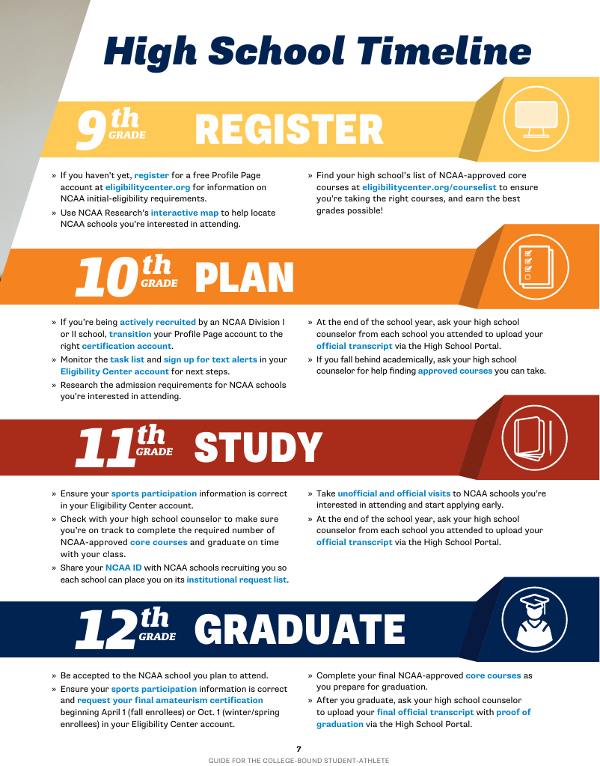

Slide 37
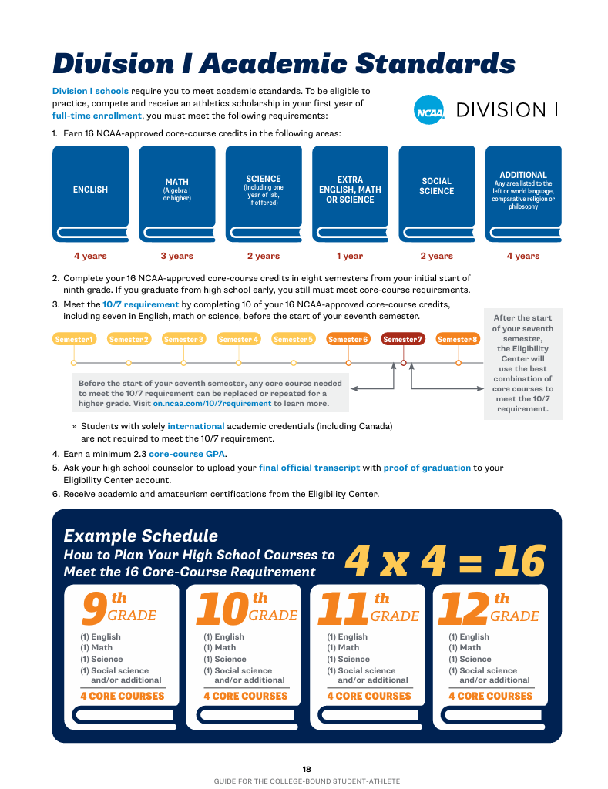

Slide 38
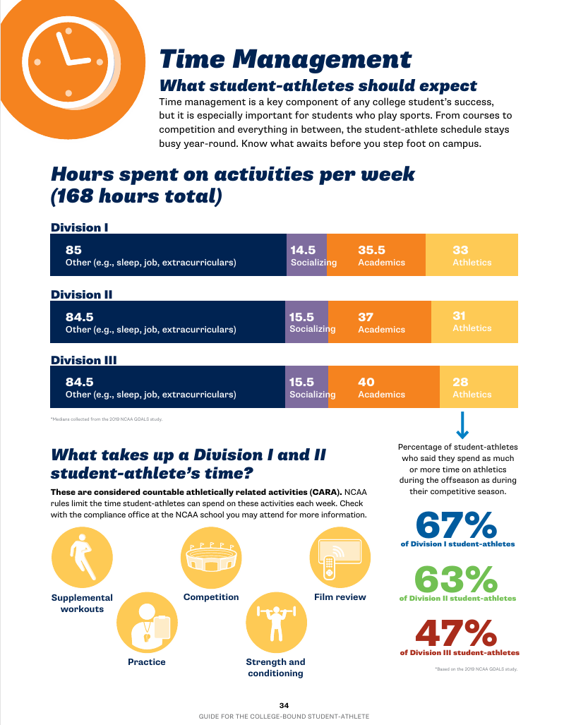

Slide 39
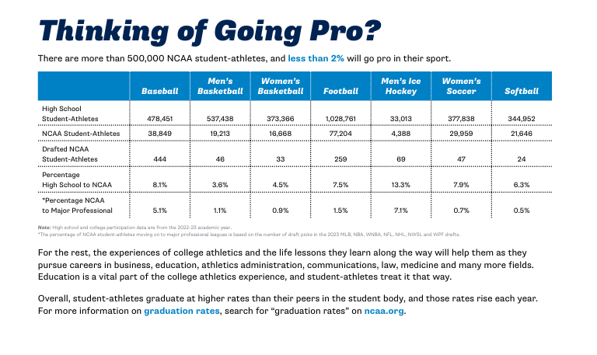

Slide 40
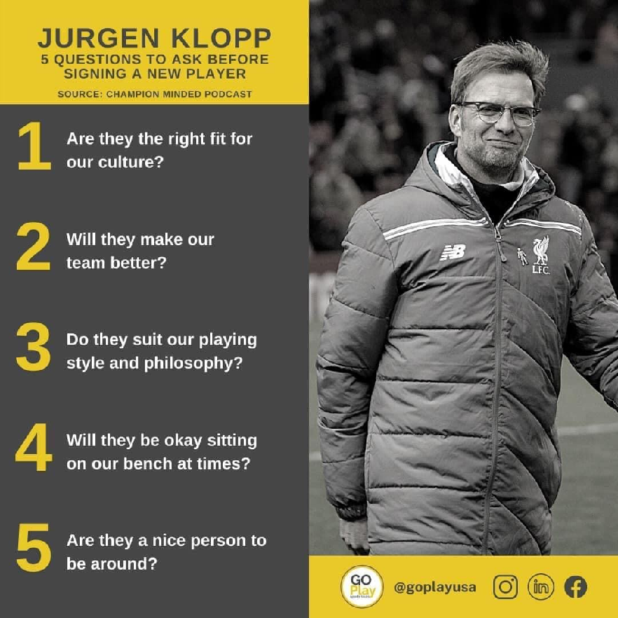
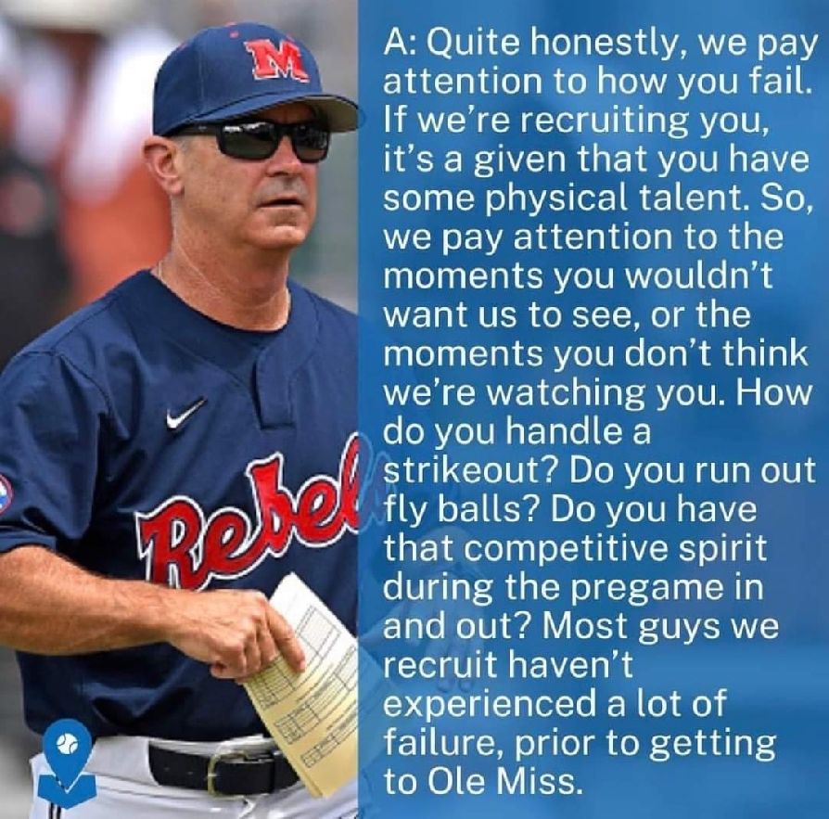
What are coaches looking for?

Slide 41
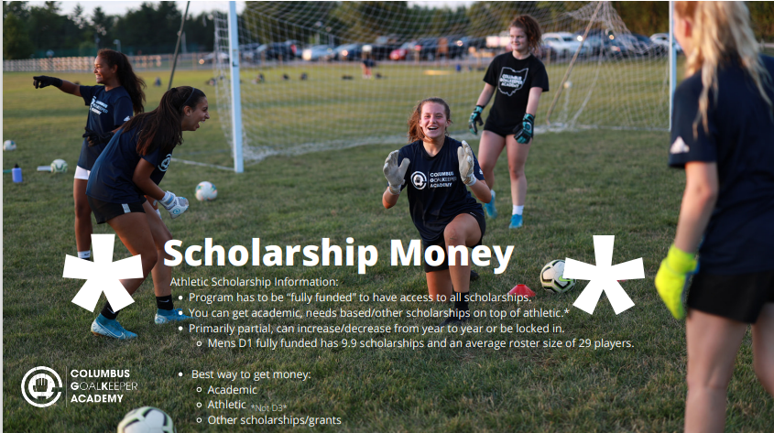

Slide 42
How does Nagele College Planning help me?

Slide 43
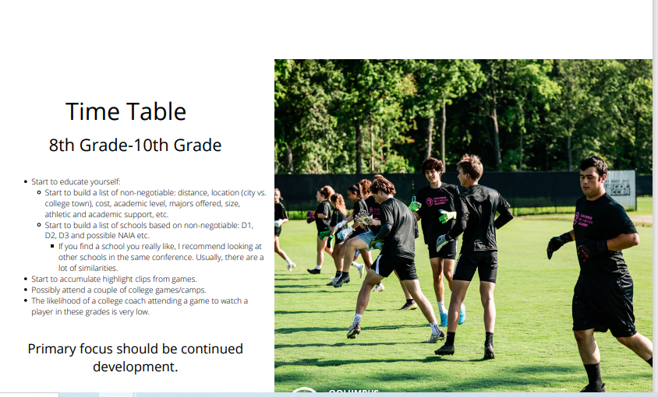
When should we start working together?

Slide 44
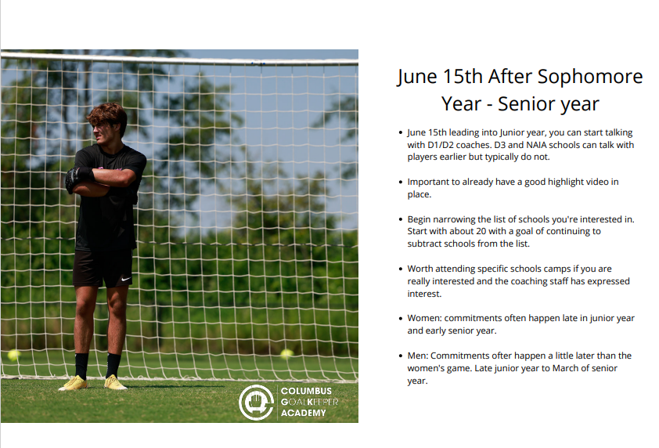

Slide 45

Example of College Communication
As per NCAA Rules, I am not allowed to officially email, call or text you regarding recruiting and the University of Tampa until June 15th going into your junior year.
You are however allowed to email, call and text us at any time we just cannot respond or return phone calls until then. If you do call and we connect, we can then discuss University of Tampa. You are also allowed to visit campus at any time... So please let us know if you could like to set that up.
Lastly, you are allowed and encouraged to keep us updated with your games, events, tournaments… we would love to hear from you!!!

Slide 46
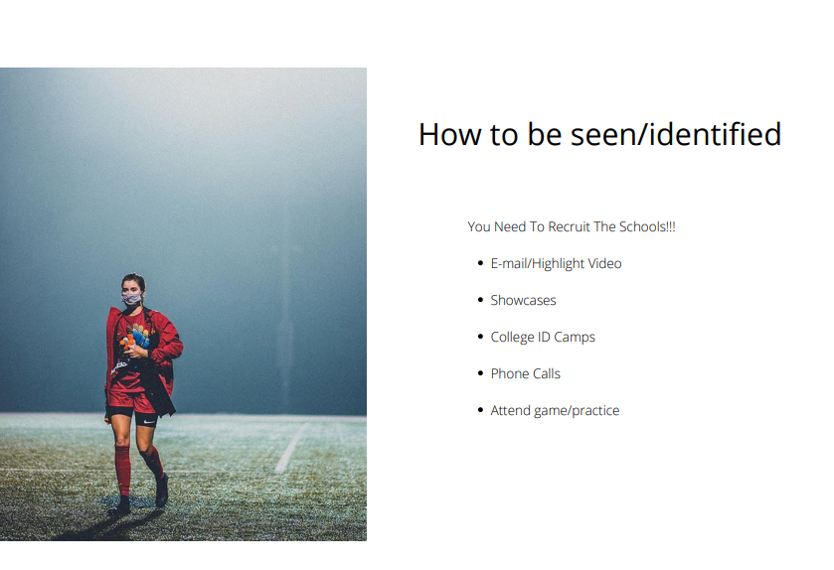

Slide 47
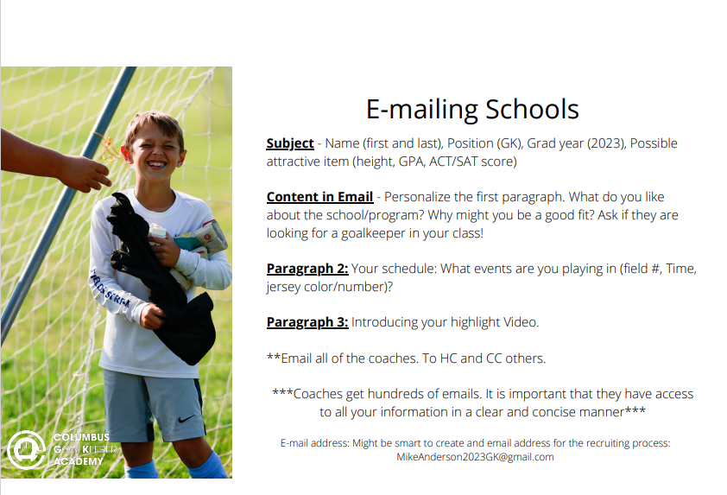

Slide 48
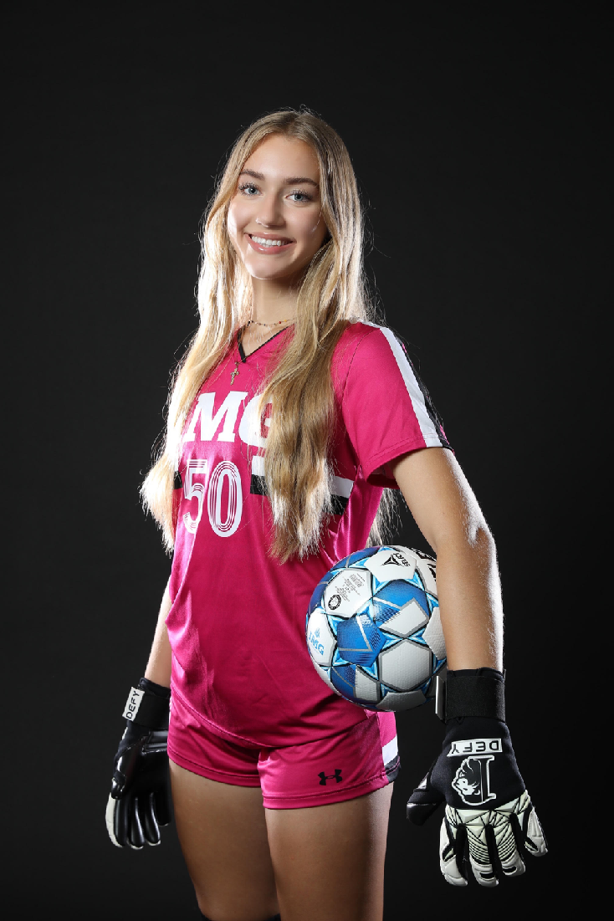
Email Signature Best Practice
Kaiya Scarpo
Class of 2024
5'11 Goalkeeper
IMG U19 Premier
Personal Contact: 813-997-7192/kaiya.scarpo@img.education
Head Coach: Ray Leone (941-524-1537/raymond.leone@img.com)
Assistant Coach: Kelsey Harris (602-639-1466/kelsey.harris@img.com)
Head of Goalkeeping: Paul Jennison (941-243-1569/paul.jennison@img.com)
Certified College Advisor with Advanced Credentials: Siggi Nagele (727-424-4071/siggi.nagele@gmail.com)
Link to Profile (to learn more about you)
Link to Highlight Video (to get an initial idea of your skill set)
Link to Transcript (to see what kind of student you are and possibly use to make an offer)

Slide 49
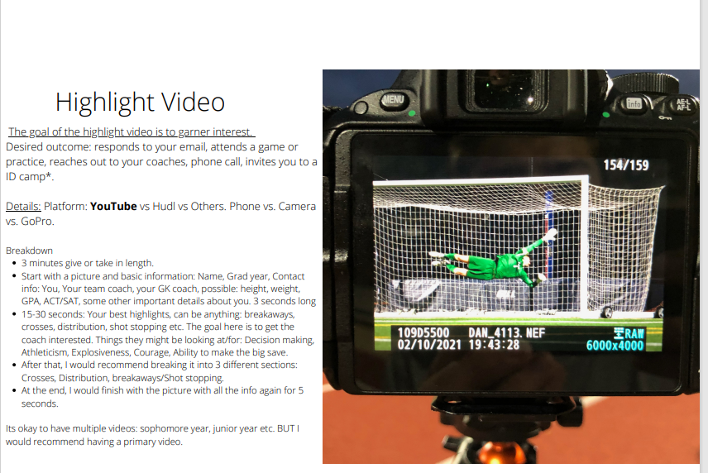

Slide 50
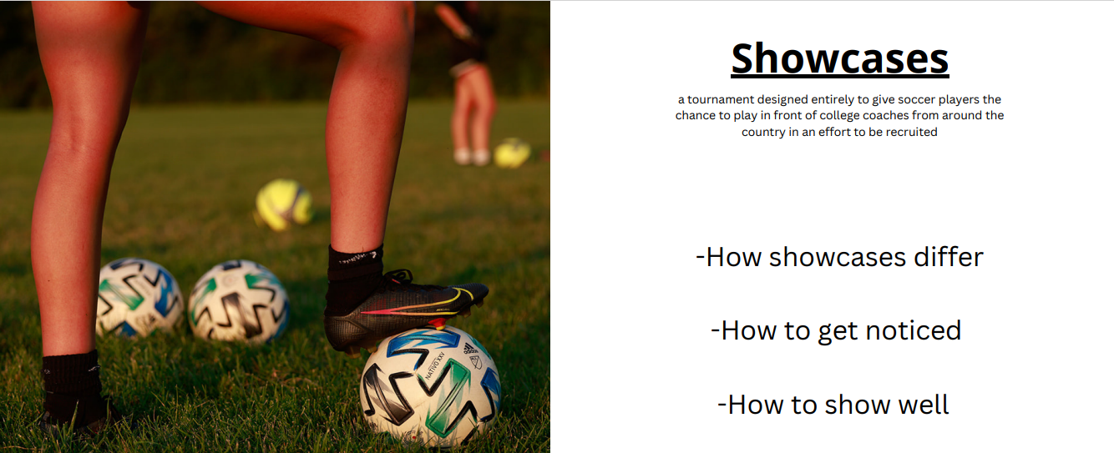

Slide 51
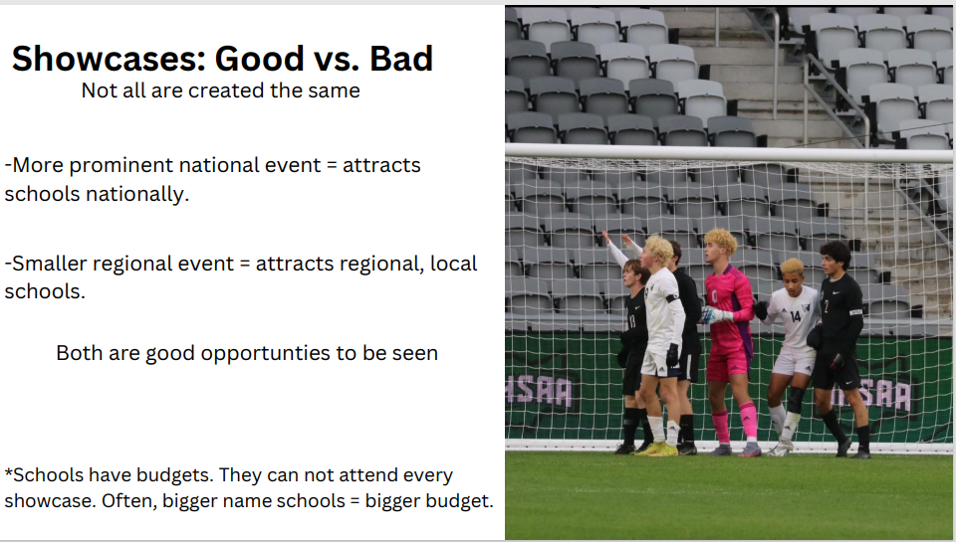

Slide 52
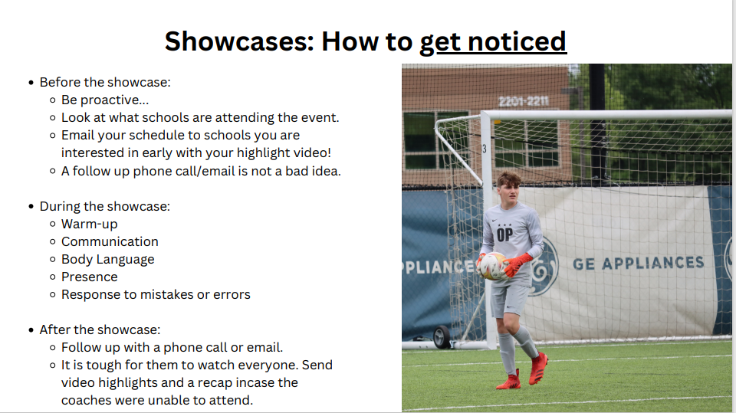

Slide 53
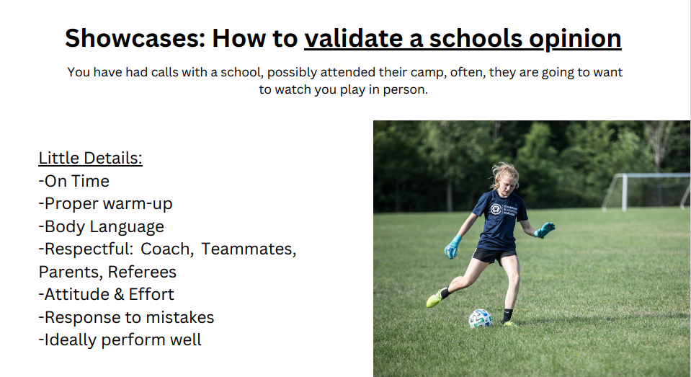

Slide 54
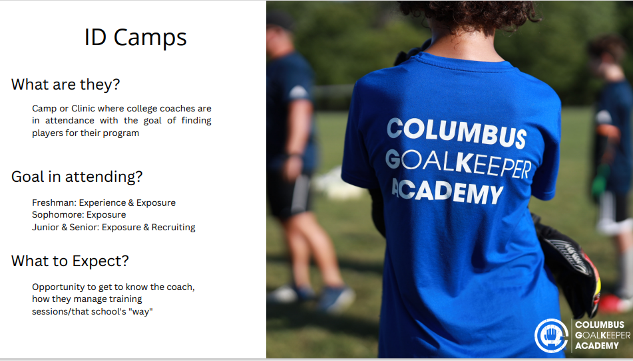

Slide 55
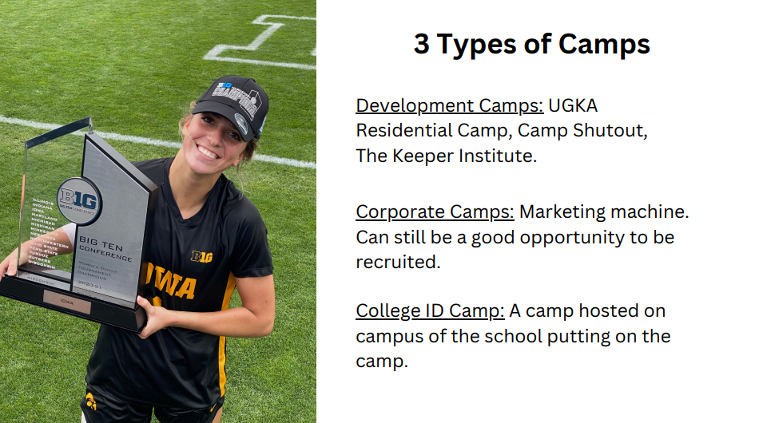

Slide 56
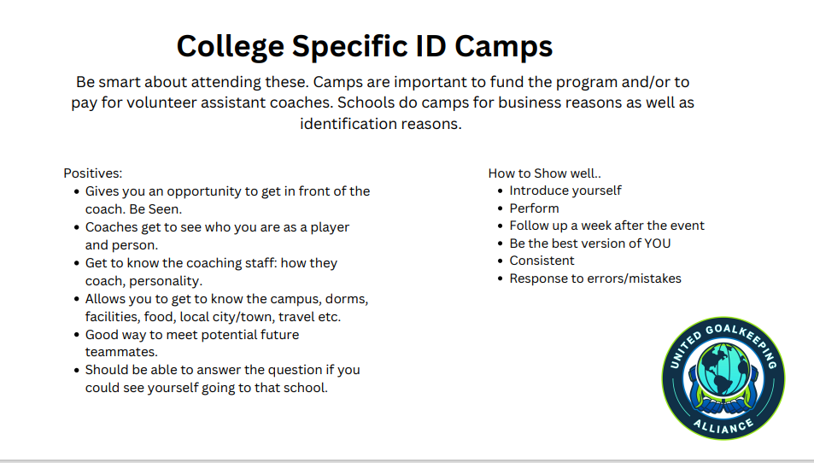

Slide 57
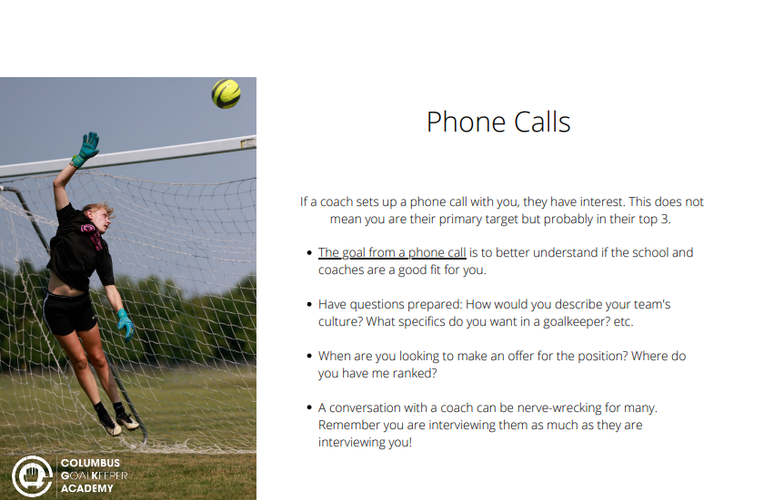

Slide 58
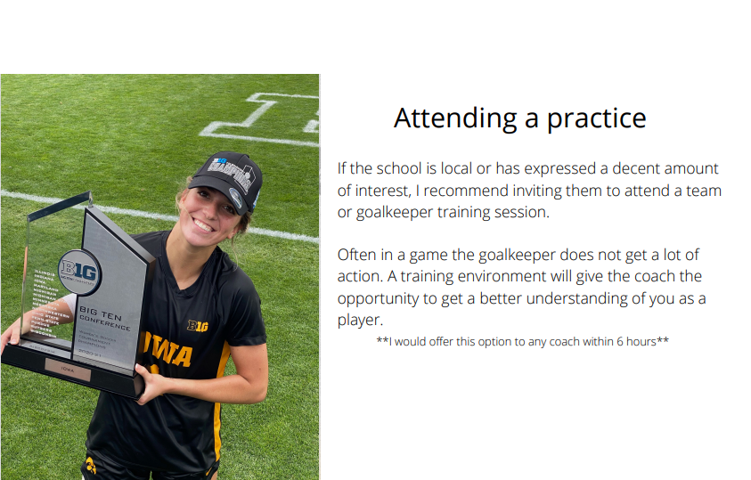

Slide 59
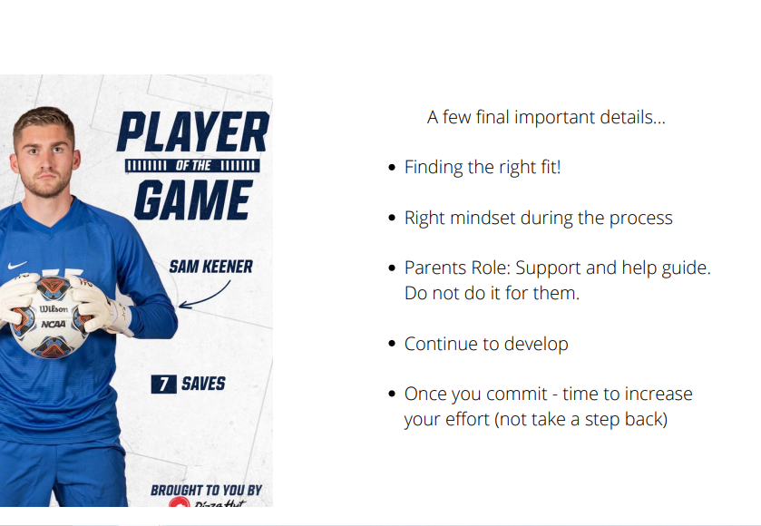

Slide 60
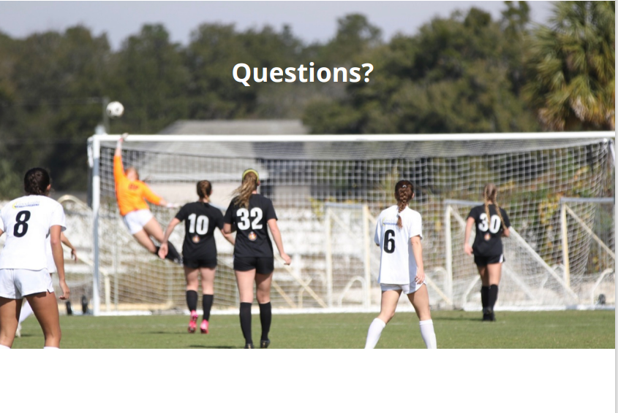

Slide 61
Thank you from:

